Slide 1
Chapter 14 Conclusions: The Future of Wellness Management in Foodservice, Hospitality, and Tourism Businesses
Dr. Bendegul Okumus
Heather Linton Kelly

Slide 2
Learning Outcomes
Describe what wellness programs and offerings EVEN Hotels provide to its guests
Draw conclusions from previous chapters
Discuss current and future generations’ expectations from health and wellness
Offer discussions on future of wellness concepts

Slide 3
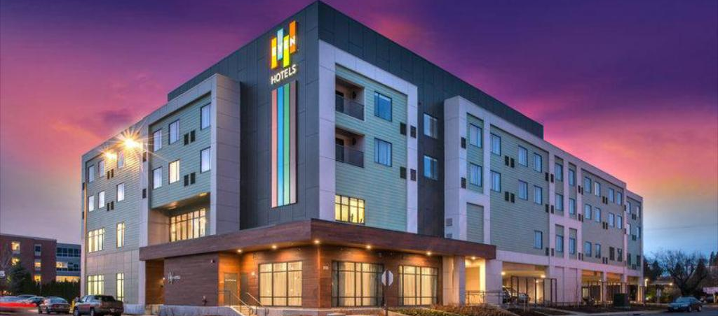
Case Study: EVEN Hotels
Click to watch EVEN Hotels Brand Highlight: https://www.youtube.com/watch?v=HTl76bdcqJE

Slide 4
Revisiting Wellness Management Concepts
Primary and Secondary Wellness Travel
Identifying a Destination’s Unique Wellness Offerings
Customization and Personalization
Wellness Food
Wellness Spas and Hot Springs
Wellness Events
Workplace Wellness
Notes:
Image from https://spiritualityhealth.com/articles/2018/03/14/forging-a-healing-path

Slide 5
Current and Future Generations’ Expectations from Health and Wellness
Silent Generation (born before 1945)
Baby Boomers (born approximately 1946-1964)
Generation X (born approximately 1965-1979)
Still active travelers and currently make up around one third of the global population
More traditional travelers, often looking for standardized itineraries and guided tours, but have their own unique needs and preferences
Gen X women in particular are looking for a respite from their hectic lives on a relaxing retreat involving activities like meditation, mindfulness, spa treatments, yoga, healthy eating and outdoor activities

Slide 6
Current and Future Generations’ Expectations from Health and Wellness
Generation Y / Millennials (born between 1980-1994)
Approx. 1.75 billion members globally and 73 million in the U.S.
Want experiences that are ‘Authentic,’ ‘Connected,’ and ‘Dynamic’
Want to be more like the “idealized versions” of themselves that they portray on social media, and look for social validation through peer responses to their posts
May be less healthy than Gen X was at the same age
Want to attend a retreat with a famous fitness influencer, guided meditation practice with a spiritual leader, forest bathing in a remote location, challenging hikes and hot springs, and other unique experiences

Slide 7
Current and Future Generations’ Expectations from Health and Wellness
Generation Z (born between 1995-2010)
Approx. 1.85 billion members globally and 74 million in the U.S.
Young, fiscally conservative, and digitally connected
Relatively brand agnostic and often use the sharing economy while traveling
Take a holistic view of health, paying attention to physical fitness, healthy eating, and mental well-being
Use apps and wearable technology to track workouts and manage their health
More socially conscious than previous generations
Look for eco-friendly trips, sustainable hotel practices, and ways to do good in the local community they are visiting

Slide 8
Current and Future Generations’ Expectations from Health and Wellness
Generation Alpha (born between 2011-2025)
Estimated to reach 2 billion worldwide
Still young and reliant on their parents, but want to be involved in the travel process, and parents take their input seriously
Expected to embrace experiences and personalization at an even higher level than previous generations
Notes:
Image from https://fistfuloftalent.com/2017/12/ready-generation-alpha.html

Slide 9
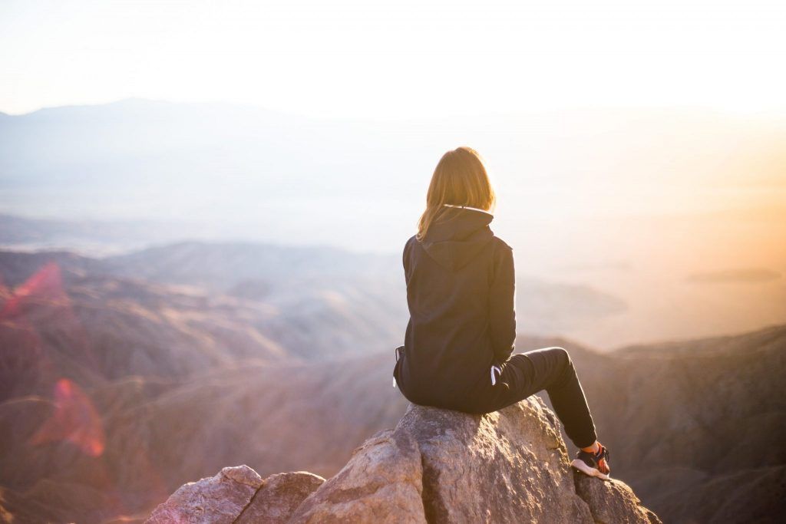
Future of Wellness Concepts
Taking on Overtourism
Digital Detoxing
Role of Technology on Future Wellness Concepts
A Focus on Sleep
Inspiration from Other Cultures
Incorporating Health, Wellness, and Daily Life
Wellness and Sustainability
Aging Well

Slide 10
Crises, Disasters, and Pandemics
Short-Term
People are likely to cancel or postpone upcoming trips to wellness destinations or facilities, to lessen their risk of exposure
May move their plans to a closer facility, such as a local spa or retreat center, or may simply stay home
Wellness businesses need to communicate with their clientele, offer incentives to postpone their trip rather than cancel it completely, and move their offerings online whenever possible
Longer-Term
People will continue to travel
May focus more on ongoing wellness initiatives like boosting their immune systems and improving their overall health to protect themselves in case of future pandemics
Continue practicing social distancing by traveling to wellness places with fewer people

Slide 11
Summary
EVEN Hotels offers travelers a way to stay happy and healthy when they are away from home.
This textbook has discussed: Primary and Secondary Wellness Travel, Identifying a Destination’s Unique Wellness Offerings, Customization and Personalization, Wellness Food, Wellness Spas and Hot Springs, Wellness Events, and Workplace Wellness.
The silent generation was born before 1945, Baby Boomers were born between 1946 and 1964, and Generation X was born between 1965 and 1979.
These three generations are considered tradition travelers.

Slide 12
Summary
Gen X women are looking for respite from their hectic lives.
Generation Y is born between 1980 and 1994.
This generation is looking for authentic, connected, and dynamic experiences.
Generation Z was born between 1995 and 2010.
This generation has a more holistic view of health.
Bleisure travel is when travelers mix business trips with leisure.
Generation Alpha is born starting in 2011 and will approximately end in 2025.
This generation tends to expect instant gratification and is selfish.
Overtourism is too many visitors overwhelming and ruining a particular destination.

Slide 13
Summary
Digital detoxing is when people take a break from social media and electronic devices.
Sustainable travel is finding a way that tourism can be maintained long-term without harming natural and cultural environments.
Pandemics, especially widespread ones like COVID-19, can cause the hospitality industry and tourism to come to a halt and can affect wellness tourism and travel as a result.

